Slide 1
LaTeX Workshop for Beginners
University of Oklahoma
CODE Workshop
August 2 & 3, 2023, 9:30-11:30am

Slide 2
Contents of this workshop
Today we will talk about
What | What is LaTeX?
Why | Why should you use LaTeX?
How | How do you use LaTeX?
Where | Where do I go when I have questions or want to learn more?

Slide 3
Table of contents
01
02
03
04
What Is LaTeX?
How Do We Use it?
What is LaTeX? Why is it pronounced like that? What’s up with the weird capitalization?
How do we access it? Where do we start? What do I do when I’m there?
Resources
Practice
Resources to go to when you don’t know how to do the thing you want to do.
Some prompts and exercises to get you exploring.

Slide 4
01
What is LaTeX?

Slide 5
What is LaTeX?
LaTeX (pronounced Lah-tek or Lay-tek) is a software system for document preparation, similar to Word or Docs, but allows for more technical scientific writing, math symbols, and more customizable formatting.
It is largely used in academic writing, especially in STEM related fields, however can be used for any document preparation including essays, resumes, and CVs.

Slide 6
02
How Do We Use LaTeX?

Slide 7



Where to Access LaTeX
Local Computer
Web/Cloud
Download software to use locally on your device.
Overleaf.com, a cloud based system like Google Docs for LaTeX
Mac
Windows

Slide 8
Where to Access LaTeX
Local Computer
Web/Cloud
Download software to use locally on your device.
Overleaf.com, a cloud based system like Google Docs for LaTeX
Mac
Windows
Notes:
Local: best for when you don’t have internet access. I use this if I need to use LaTeX while travelling.
Overleaf: Free account, can access on any internet accessible device, can collaborate with others

Slide 9
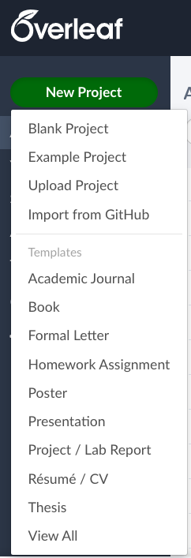

Let’s Jump In!
Create a free account on overleaf.com
Open a blank project to follow along
AND/OR
Follow the QR code or link to my sample project/tutorial
https://www.overleaf.com/read/msfvdvhppcbg

Slide 10
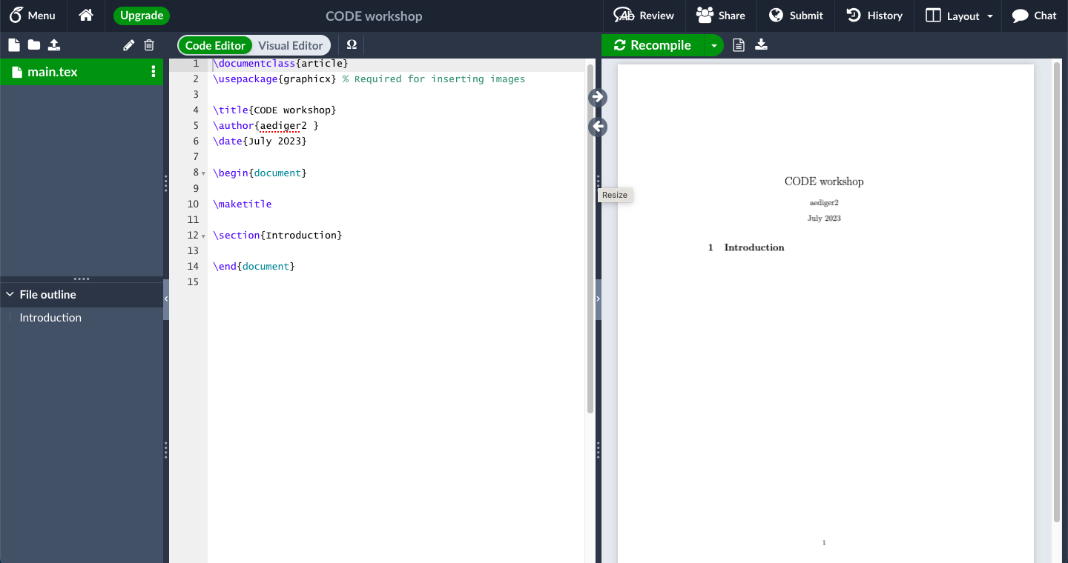

Slide 11
Documents in this project

Slide 12
Sections in your document

Slide 13
A preview of your document. Click “Recompile” to reload new changes.

Slide 14
Your “code”
“\begin{document}” and above is called the preamble and is the document set up. Here you can add packages, change formatting, and declare shortcuts.
Below it is the contents of your document and what shows up in the preview.

Slide 15
Title and editor type.
The default is code editor.

Slide 16
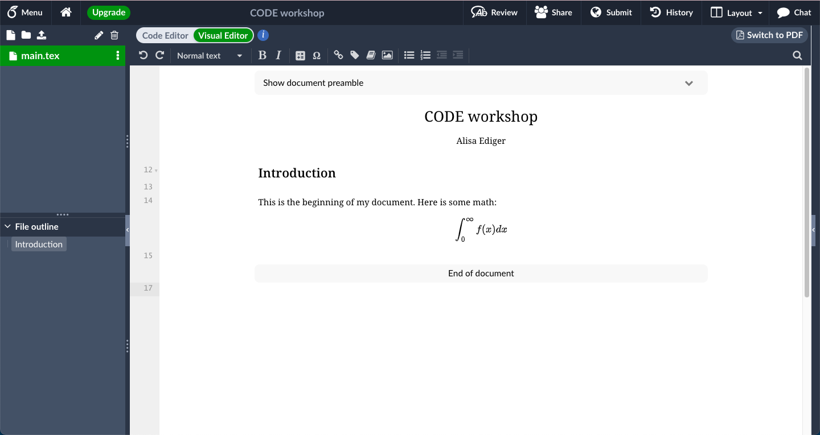
Visual editor looks more like your document

Slide 17
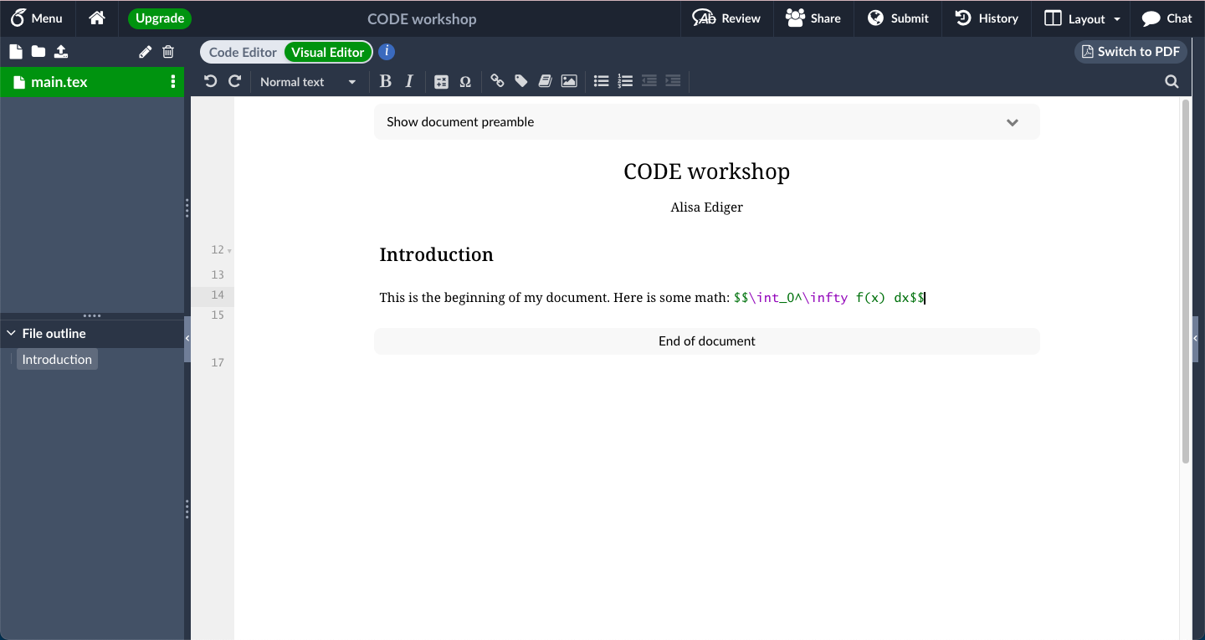
Click on something to edit it

Slide 18
Special Characters
$
\
&
{ }
Enter and exit math mode
Use one \ for the start of a command. Use two together \\ for a line break
The alignment symbol (more on this later)
Used to define the input of a command
%
#
^ and _
Use a % at to comment out a line so it won’t show up in the formatted document
Used to reference arguments.
Superscript and subscript. These are math mode commands

Slide 19
Special Characters
$
\
&
{ }
Enter math mode: Use one $ at the beginning and end math to keep it in-line. Use two or display mode: centered on a new line
Use one \ for the start of a command. Use two together \\ for a line break
The alignment symbol (more on this later)
Used to define the input of a command
If you want to use any of these symbols as text, you need to put a backslash in front of them (except the backslash and carat)
%
#
^ and _
Use a % at to comment out a line so it won’t show up in the formatted document
Used to reference arguments.
Superscript and subscript. These are math mode commands

Slide 20

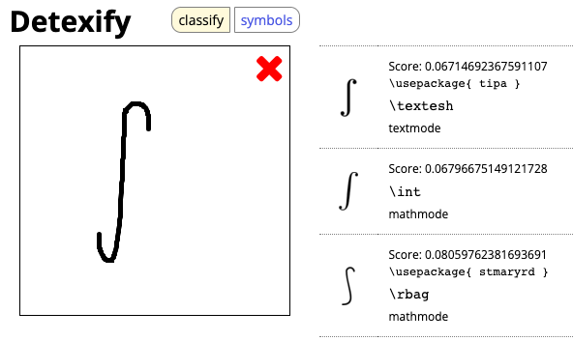
All the Math Symbols
If you can draw it, you can TeX it with DeTeXify
Use your mouse or stylus to draw

Slide 21
All the Math Symbols
If you can draw it, you can TeX it with DeTeXify
Possible results:

Slide 22
All the Math Symbols
If you can draw it, you can TeX it with DeTeXify
Text mode does not go in $ or $$

Slide 23
All the Math Symbols
If you can draw it, you can TeX it with DeTeXify
Math mode does go in $ or $$

Slide 24
All the Math Symbols
If you can draw it, you can TeX it with DeTeXify
If it has \usepacage{}, you need to put this in your preamble

Slide 25
Shortcuts, Commands & Environments
Shortcuts can be defined for things you type often
Commands take inputs
Environments format larger sections

Slide 26

Add an image
Upload your image file
Use command includegraphics withe the file name in brackets

Slide 27
03
Resources

Slide 28


Resources
Detexify
Stack Exchange
Quiver
Best place to find help with LaTex questions
Best place to find help with LaTex questions
Draw diagrams to get the LaTex code

Slide 29
04
Practice

Slide 30
04
Practice

Slide 31
Try it!
Can you open a template in overleaf and change the title, name, and date? Find something in the code you don’t understand and try looking it up on Stack Exchange.
Can you write the Pythagorean Theorem? What about the Quadratic Formula? Hint: Try to see if you can figure out the commands for a fraction and square root without looking them up by using Overleaf's autofill feature. Try using DeteXify for the plus/minus symbol.
Define a shortcut and a new command.
Find something in the workshop TeX file we did not discuss. Try explaining it to someone next to you and see if you can walk them through it.
Start your own project that you could use in your field.

